Slide 1
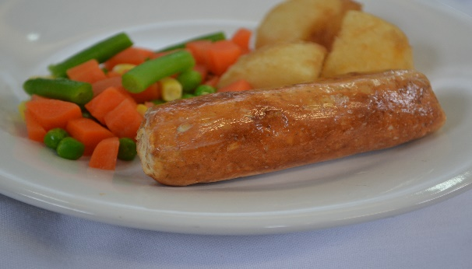
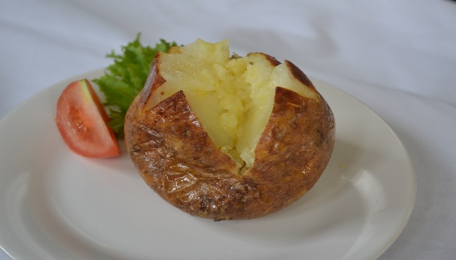
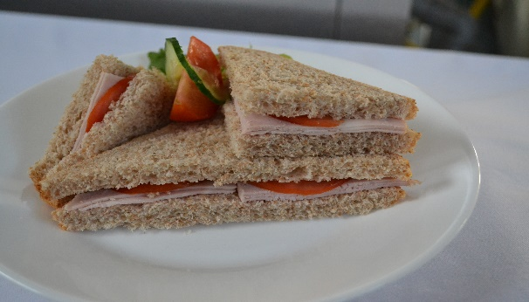
Week 1 Monday
Primary School
Sizzling Chicken Sausage
Filled
Jacket Potato Choice of Cheese or Baked Beans
Sizzling Quorn Sausage
Sandwich Selection

Slide 2
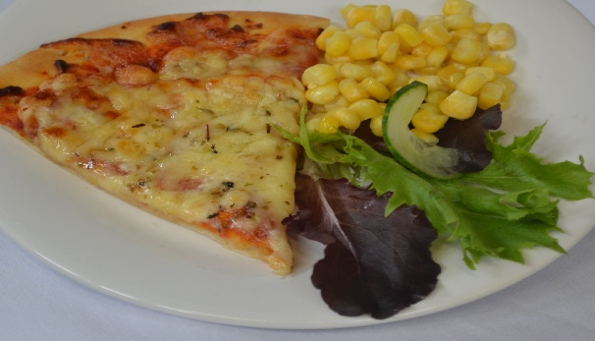

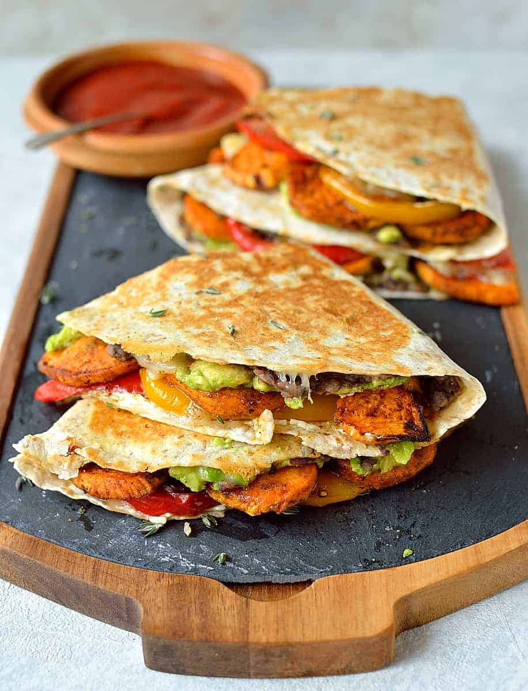
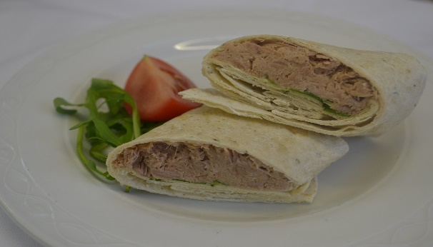
Week 1 Tuesday
Week 1 Tuesday
Primary School
Filled Jacket Potato Choice of Cheese
Baked Beans
or Tuna
Cheese & Tomato Pizza
Oven Baked Quesadilla
Sandwich Selection

Slide 3
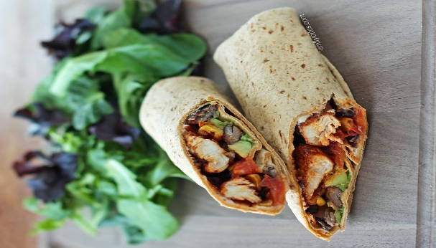

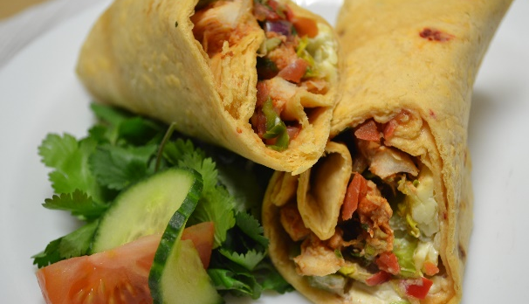
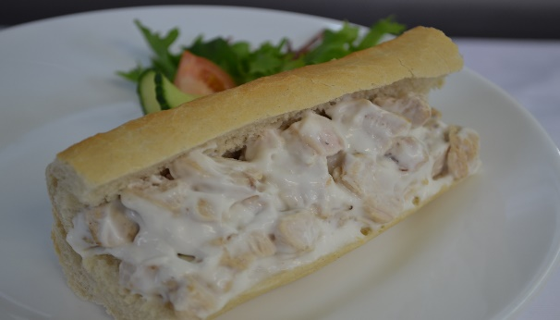
Week 1 Wednesday
Week 1 - Wednesday
Week 1 Wednesday
Primary School
Filled Jacket Potato Choice of Cheese
Baked Beans
or Tuna
Seasoned Chicken Wrap
Mexican Style Burrito
Sandwich Selection

Slide 4
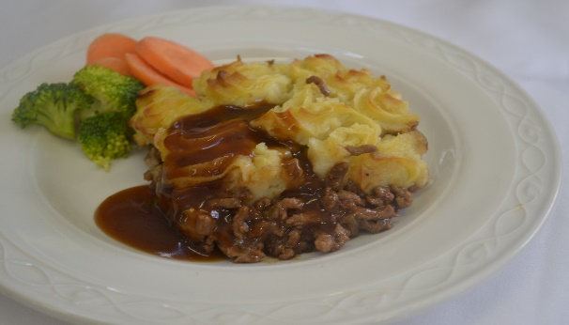
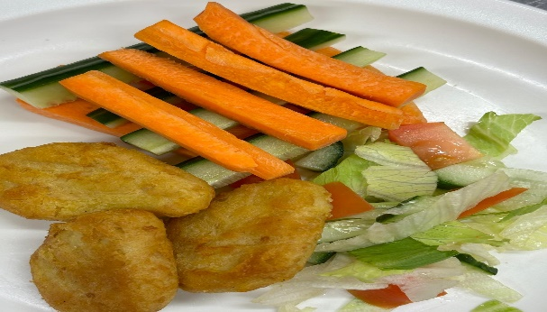
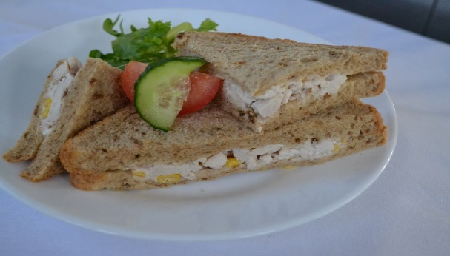
Week 1 Thursday
Week 1 - Thursday
Week 1 Thursday
Moorside Primary School
Filled Jacket Potato Choice of Cheese or
Baked Beans
or Tuna
Halal Cottage Pie
Crispy
Quorn
Dippers
Sandwich Selection

Slide 5
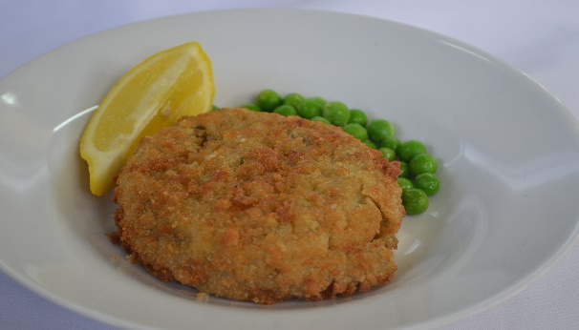
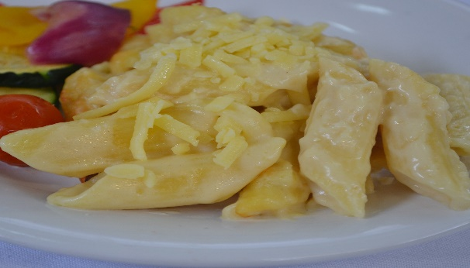
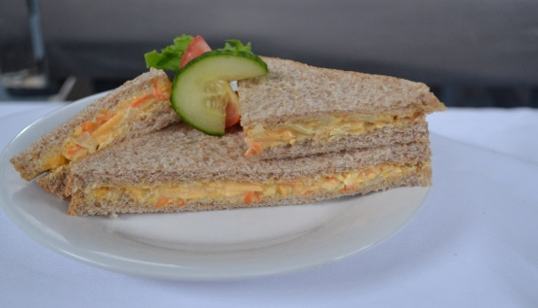
Week 1 Friday
Week 1 - Friday
Week 1 Friday
Primary School
Oven Baked Salmon Fishcake
Filled Jacket Potato
Choice of Cheese
Baked Beans
or Tuna
Classic Mac
& Cheese
Sandwich Selection

Slide 6
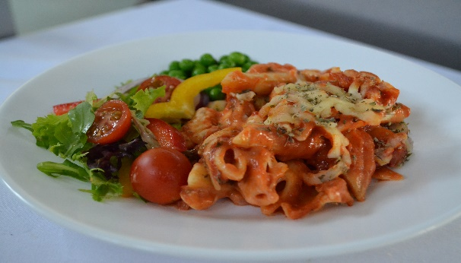
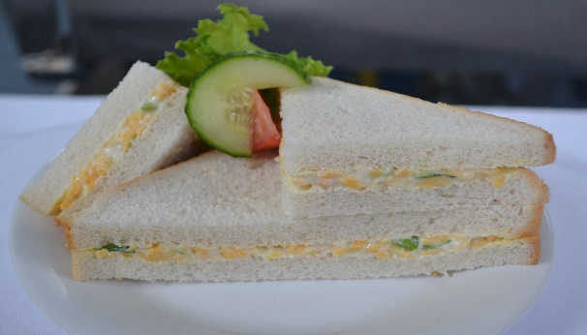
Week 2 Monday
Week 2 - Monday
Week 2 Monday
Primary School
Filled Jacket Potato
Choice of Cheese
or Baked Beans
Rich Pasta Napoli
Red
Margherita Pizza Slice
Sandwich Selection

Slide 7
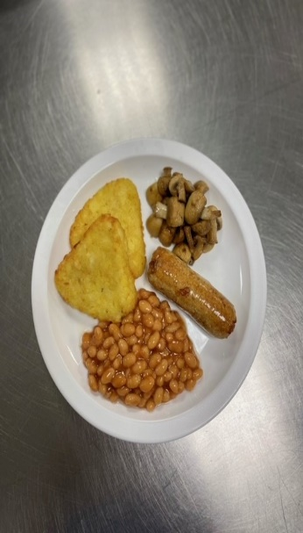
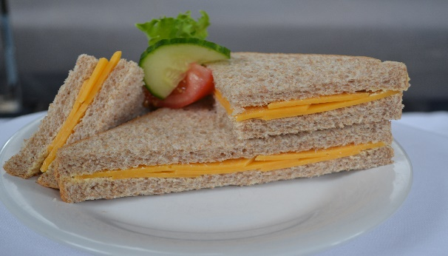
Week 2 Tuesday
Week 2 - Tuesday
Week 2 Tuesday
Primary School
Filled Jacket Potato
Choice of Cheese
Baked Beans
or Tuna
Halal All Day Breakfast
Quorn All Day Breakfast
Sandwich Selection

Slide 8
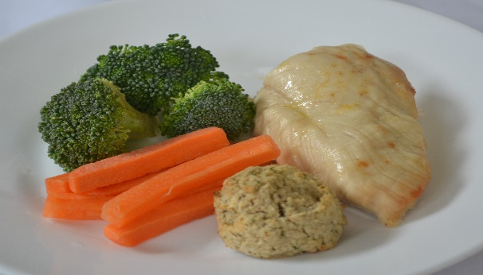

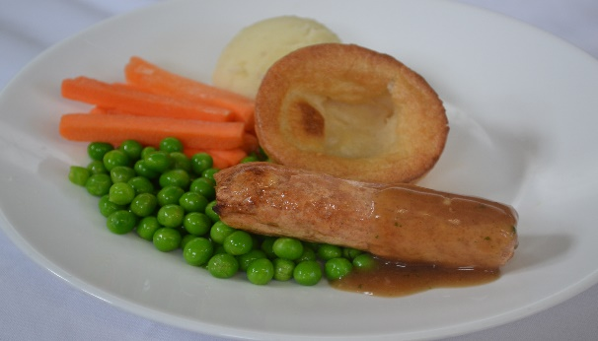
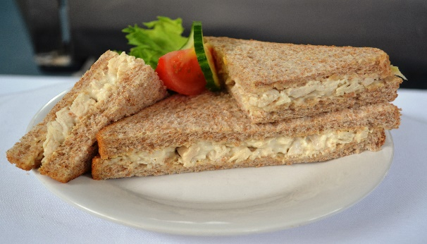
Week 2 Wednesday
Week 2 - Wednesday
Week 2 Wednesday
Primary School
Halal Roast Chicken with Yorkshire Pudding
Filled Jacket Potato
Choice of Cheese
Baked Beans
or Tuna
Quorn Sausage with Yorkshire Pudding
Sandwich Selection

Slide 9
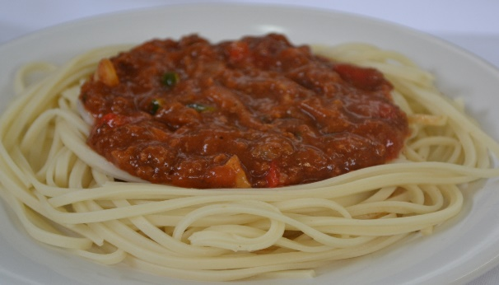
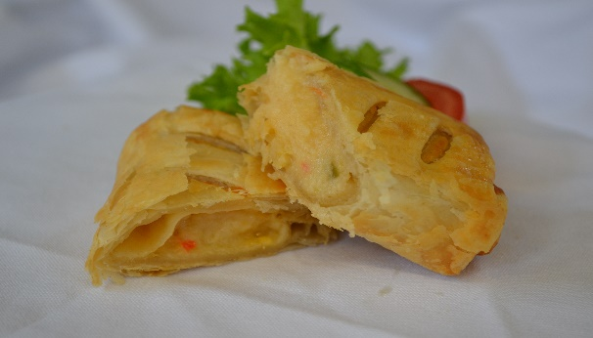

Week 2 Thursday
Week 2 - Thursday
Week 2 Thursday
Primary School
Filled Jacket Potato
Choice of Cheese
Baked Beans
or Tuna
Halal Beef Bolognese
Red
Oven Baked Cheese Roll
Sandwich
Selection

Slide 10
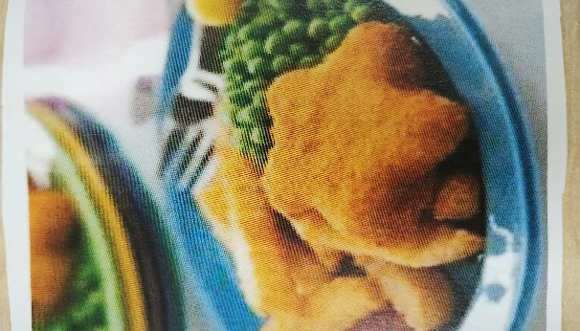
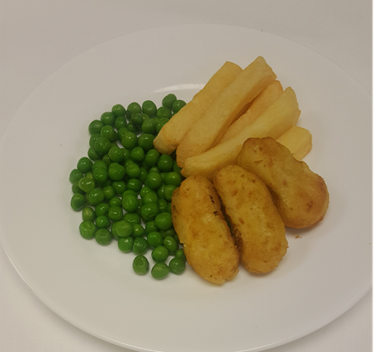
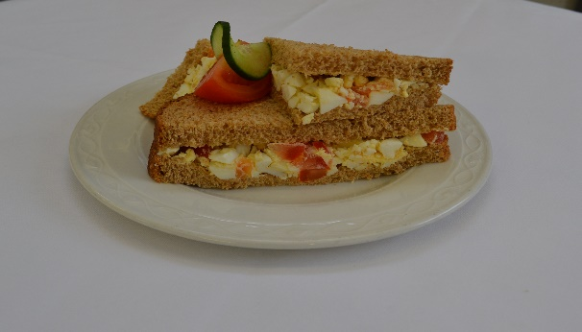
Week 2 Friday
Week 2 - Friday
Week 2 Friday
Primary School
Filled Jacket Potato
Choice of Cheese
Baked Beans
or Tuna
Breaded Fish Star
Crispy
Quorn Fingers
Sandwich Selection

Slide 11
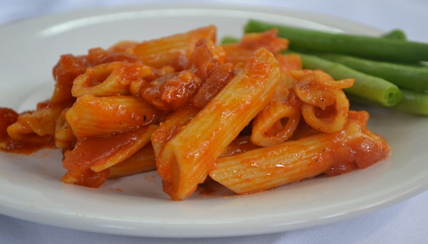
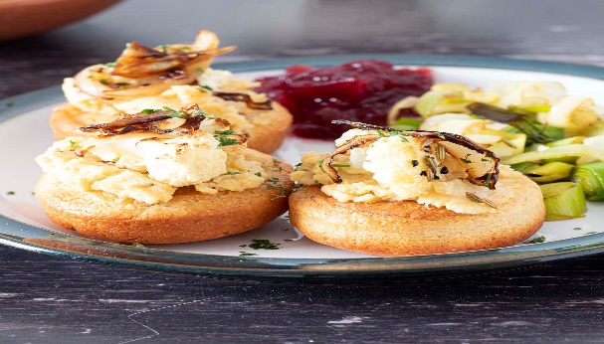
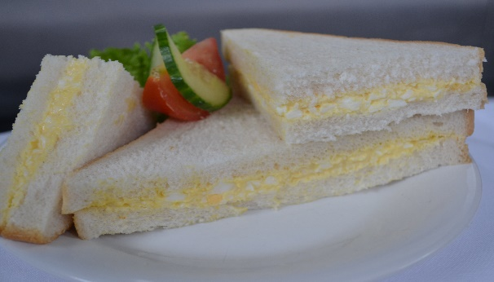
Week 3 Monday
Week 3 - Monday
Week 3 Monday
Primary School
Rich Pasta Pomodoro
Filled Jacket Potato
Choice of Cheese
Baked Beans
or Tuna
Cauliflower Loaded Yorkshire Pudding
Sandwich Selection

Slide 12
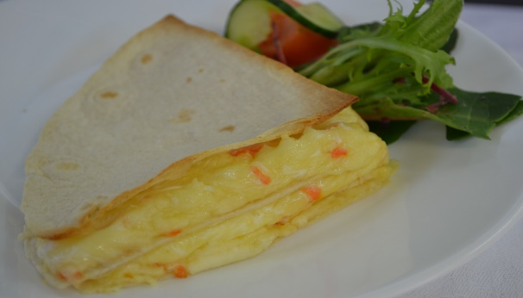
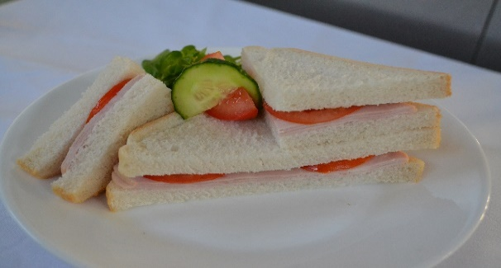
Week 3 Tuesday
Week 3 - Tuesday
Week 3 Tuesday
Primary School
Halal Seasoned Chicken Wrap
Filled Jacket Potato
Choice of Cheese
Baked Beans
or Tuna
Oven Baked Tortilla Stack
Sandwich Selection

Slide 13
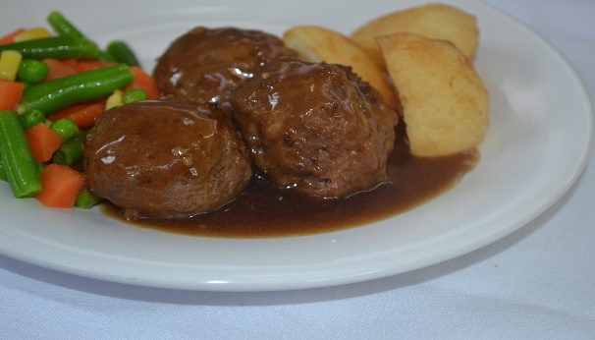
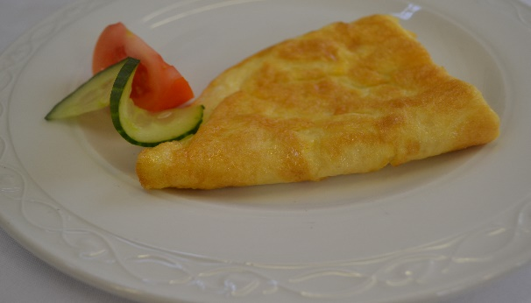
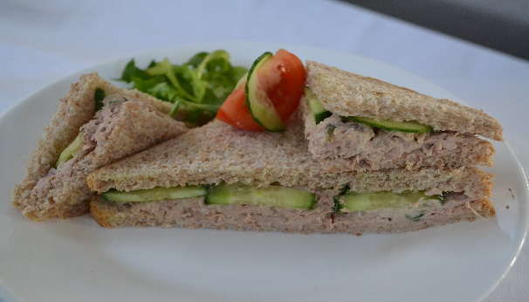
Week 3 Wednesday
Week 3 - Wednesday
Week 3 Wednesday
Primary School
Filled Jacket Potato
Choice of Cheese
Baked Beans
or Tuna
Hearty Quorn Meatballs
Red
Herby Cheese Omelette
Sandwich Selection

Slide 14
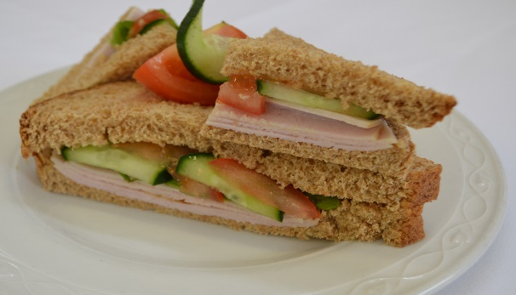
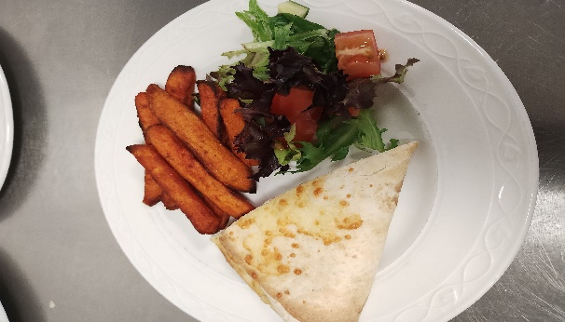
Week 3 Thursday
Week 3 - Thursday
Week 3 Thursday
Primary School
Filled Jacket Potato
Choice of Cheese
Baked Beans
or Tuna
Classic Halal Beef Quesadilla
Classic Cheese Quesadilla
Sandwich Selection

Slide 15
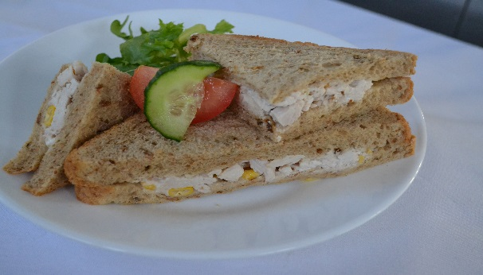
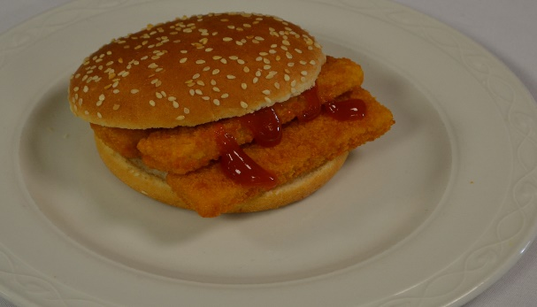
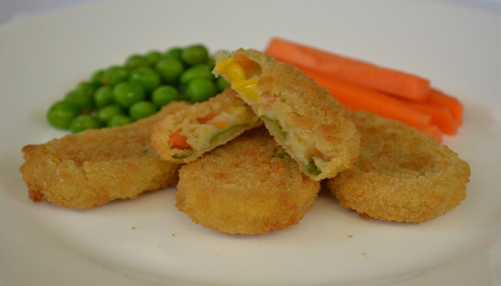
Week 3 Friday
Week 3 - Friday
Week 3 Friday
Primary School
Golden Fish Finger Sandwich
Filled Jacket Potato Choice of Cheese Baked Beans or Tuna
Blue
Sandwich Selection
Crispy Rainbow Fingers
Green

